Slide 1
CERTIFICATE VERIFICATION SYSTEM USING QUICK RESPONSE (QR) CODE (CASE STUDY FOR FEDERAL POLYTECHNIC, MUBI ) BY MERMBEE AONDAVER GUBEH (ST/CS/HND/21/037) BEING A PROJECT PROPOSAL SUBMITTED TO THE DEPARTMENT OF COMPUTER SCIENCE, SCHOOL OF SCIENCE AND TECHNOLOGY, FEDERAL POLYTECHNIC, MUBI, ADAMAWA STATE. IN PARTIAL FULFILMENT OF THE REQUIREMENTS FOR THE AWARD OF HIGHER NATIONAL DIPLOMA (HND) IN COMPUTER SCIENCE. PROJECT SUPERVISOR: MRS. LUCY B. DALHATU JULY, 2023

Slide 2
BACKGROUND TO THE STUDY
In today's digital age, the need for efficient and secure verification systems has become increasingly important. One area where this is particularly crucial is in the field of certificates. Certificates play a vital role in various domains, including education, professional qualifications, and legal documents. However, the traditional methods of verifying certificates, such as manual inspection or reliance on physical seals and signatures, can be time-consuming, error-prone, and susceptible to forgery. With the advancement of technology, the use of Quick Response (QR) codes has gained popularity as a means of storing and transmitting information. QR codes are two-dimensional barcodes that can be easily scanned using smartphones or dedicated QR code readers.
QR codes have gained traction in the field of certificate verification due to their ability to store a large amount of data in a compact format. This allows for the inclusion of comprehensive information within a single QR code, eliminating the need for manual cross-referencing or dependence on external databases. Furthermore, QR codes can be easily scanned using widely available smartphones, making them a convenient tool for both issuers and verifiers of certificates.

Slide 3
PROBLEM STATEMENT
The existing methods of certificate verification suffer from several limitations. Manual verification processes are time-consuming and can lead to delays in crucial decision-making. Physical seals and signatures are vulnerable to counterfeiting, posing a significant risk to the authenticity and integrity of certificates. Additionally, the lack of a centralized repository for certificate records further complicates the verification process, especially when dealing with certificates from different issuers or organizations.

Slide 4
AIM AND OBJECTIVES
The aim of this project is to develop a Certificate Verification System for Federal Polytechnic, Mubi using Quick Response (QR) Code. The specific objectives are as follows:
Develop a secure QR code generation algorithm that can encode relevant certificate information, ensuring data integrity and confidentiality.
Implement a centralized database system to store and manage certificate records securely.
To provide a database where Federal Polytechnic, Mubi can keep certificate records of her graduates and validate its authenticity.
Evaluate the performance and effectiveness of the proposed certificate verification system in terms of speed, accuracy, and security.

Slide 5
DISADVANTAGES OF EXISTING SYSTEM
Certificate verification method that is prevalent today is a manual process, in this process the institution/organization that want to verify a result will have to make a trip to the university or send a written request so as to verify result. The request will then go to academic affair which refer to the library or safe files to look for the duplicate certificate, this can really be time consuming, also sometimes files are lost when moved from one office to another, and in some cases, can be missing or be difficult to locate.
The registrar might be very busy with so many other letters and thereby read the letter late. It will take a while for the letter to be replied and sent back. The body that wants to verify a certificate can equally send a representative to the school; such trip will end up costing the body that needs to verify the certificate. The manual method of verifying the certificate is usually cost incurring, not fast, prone to error etc.

Slide 6
ADVANTAGES OF PROPOSED SYSTEM
The following are the advantages of the certificate verification system using QR Code. They include the following:
The system automated the manual process of certificate verification
Stored the certificate details of all graduates of any institution that adopt the use of the system.
The system minimized paperwork for certificate storage.
It also resolved the risk of tripping to and fro an institution just to verify a certificate.
The system also saves time than the manual process.

Slide 7
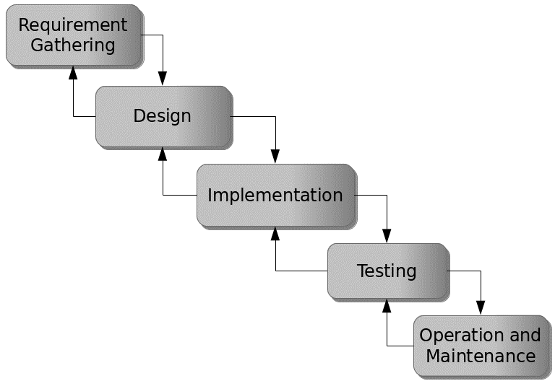
PROPOSED METHOD
The waterfall model is a traditional sequential approach to software development that consists of distinct phases that follow a linear sequence. Figure 3.1 below is a simplified version of the waterfall model for the proposed Attendance Monitoring System using QR code.
Figure 3.1: Waterfall model

Slide 8
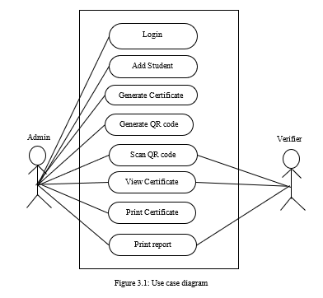
UML ALGORITHM
Use case diagram

Slide 9
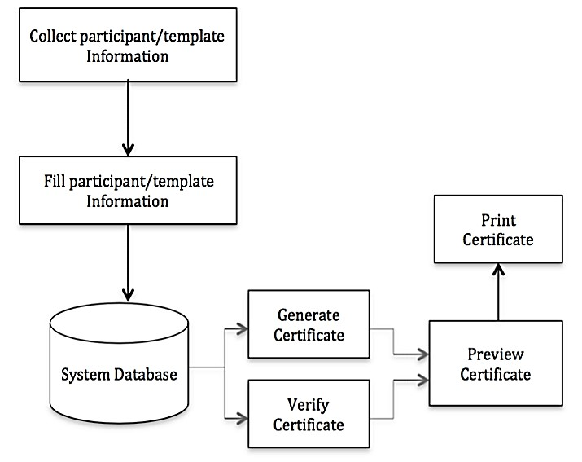
SYSTEM ARCHITECTURE

Slide 10
REFERENCES
Abolaji, O.T. (2017). CIT 333 Software Engineering 1: Course material, National Open University of Nigeria. Retrieved from http://www.nou.edu.ng/sites/default/files/2017-03/CIT333.pdf
Adams, M. & Blandford, N. (2012). An academic certification verification system based on cloud computing environment. International Journal of Machine Learning and Cybernetics, 3(1), 55-88.
Boukar, M., Yusuf, S. & Muslu, I. (2017). A Web Service Based Database access for Nigerian Universities. Certificate Verification System, 45(2).
Chandrasekaran, A., & Suthanthira, A. (2017). Acceptability of medical digital libraries. Health Informatics Journal, 8(2), 58-66. Adams, A., & Blandford, A. (2004).
Furnell, S., & Warren, M. (2018). Computer and information security handbook. Elsevier Press, New York.
GeeksforGeeks (2018, November 20). Software Engineering: System Design Strategy. Retrieved from file:///C:/Users/uncle%20kenn/Desktop/Project%20File/Cert.%20 Verification/CertVeri%20PDFs/TopDown%20Structure/Software%20Engineering%20_%20System%20Design%20Strategy%20-%20GeeksforGeeks.html
Hampo, A.J. (2011). Design and Implementation of Student Verification System. Retrieved from https://www.academia.edu/5135050.

Slide 11
THANKS FOR LISTENING

